Slide 1
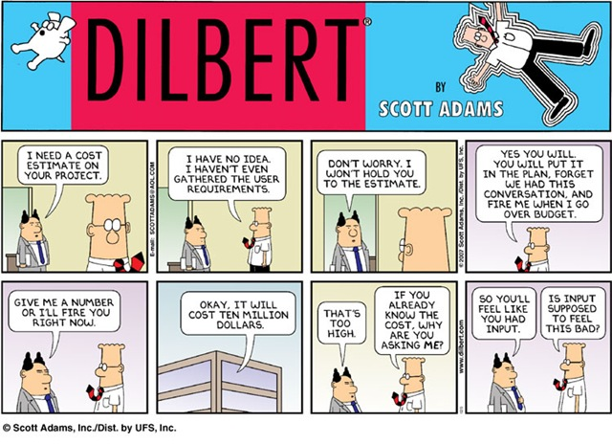

Old School Estimation
CSSE579
Session 4
Part 2
Notes:
Dilbert cartoon from http://lmsgoncalves.com/2014/08/11/sick-tired-losing-time-agile-estimations/

Slide 2
Phillips’ estimation basics
Know the purpose of the estimate, and the desired accuracy.
Use prerequisites whenever they are available.
  E.g., “How long did testing this take last time?”
Else, divide up the tasks.
Be realistic. I.e., pessimistic.
Notes:
SPMH, p 209

Slide 3
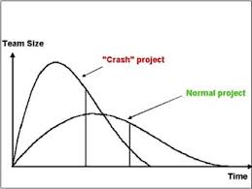
3 Models
Rayleigh
  Anticipates all stages of the process
  Doesn’t require a ton of previous data
  Estimates Staffing
  Assumes waterfall-ish
  approach
Notes:
SPMH, pp 209+
Figure from http://www.bcs.org/content/ConWebDoc/12439

Slide 4
PSP’s PROBE
Built for *individual* productivity estimates.
Relies of historical data, feeds back into the process.
Break things into really small steps.
Good for making yourself awesome.
See separate PSP reading, on Moodle.
  Most often used with design / coding / testing.
  Estimate size, time to code, defects.
  Gives you a chance to reflect on your process.
Notes:
Pp 215+

Slide 5
Philips’s Simple Estimation Technique
Relies on your ability to at least estimate small things correctly
Explicitly incorporates error
Easy and will at least get things started
Estimate = Low + 4* Most Likely + High
6
Std Deviation = High – Low
6
% Error = Std Deviation
Estimate
Notes:
Pp 220-221.

Slide 6
Try it out
Let’s use Phillips’ Simple Estimation Technique with the Piano Tuner estimates you did!

Slide 7
Estimates vs. Commitments
Takes us back to Dilbert!
An estimate doesn’t mean I’ll do something in that length of time.
Saying that you will – that’s a commitment.
Need to verify if an estimate means that!
Notes:
See SPMH, p 222.

